Slide 1

MCA - 4th Sem
Project Final Evaluation
Sensor Based Smart Agriculture Monitoring System Using (Web & IOT Based)
Presented by :-
Christin Varghese, 2023520738
Shyam Sunder Kumar , 2023570431
Under the Supervision of:-
Mr. Vishvendra Pal Singh Nagar
( Assistant Professor )
Sharda University, Gr. Noida
DEPARTMENT OF COMPUTER SCIENCE & APPLICATIONS
SHARDA SCHOOL OF COMPUTING SCIENCES & ENGINEERING
26th May, 2025

Slide 2
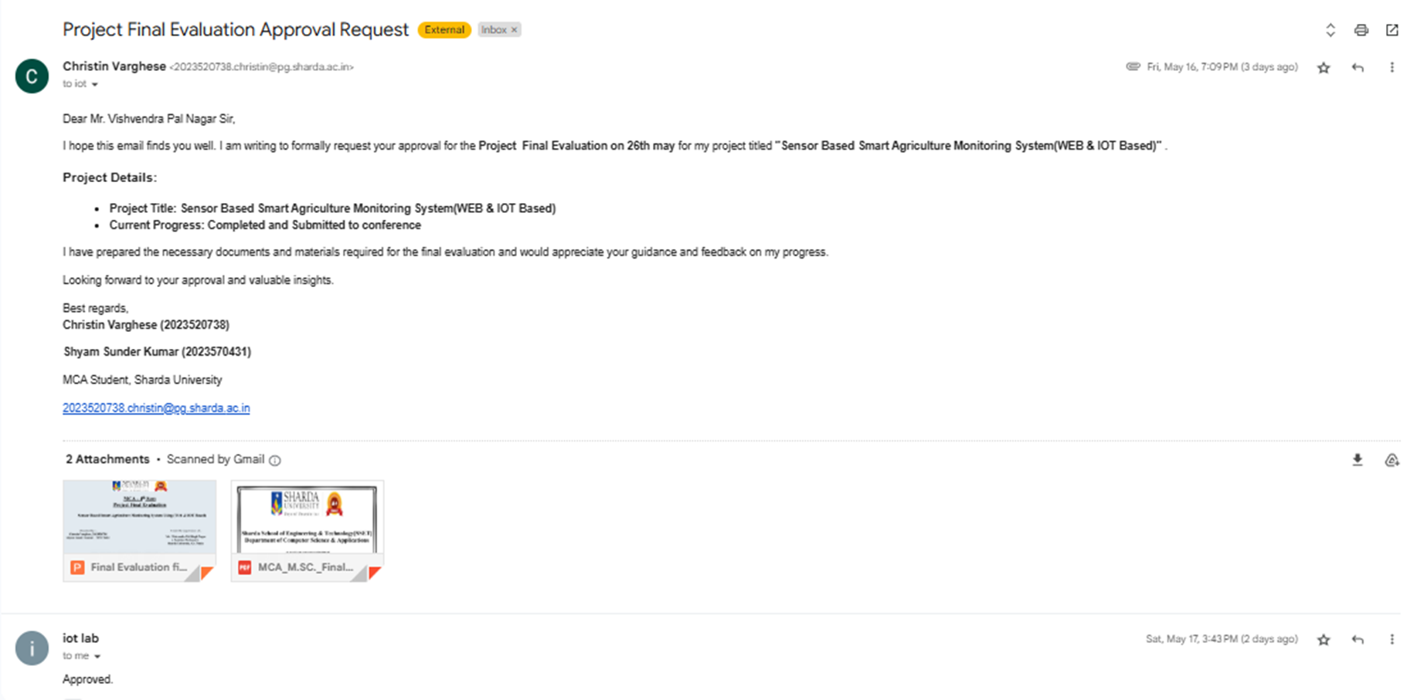
Approval from guide for the evaluation
attached and same need to pasted here

Slide 3
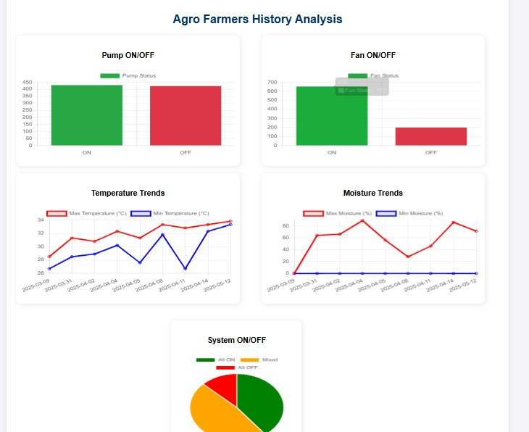
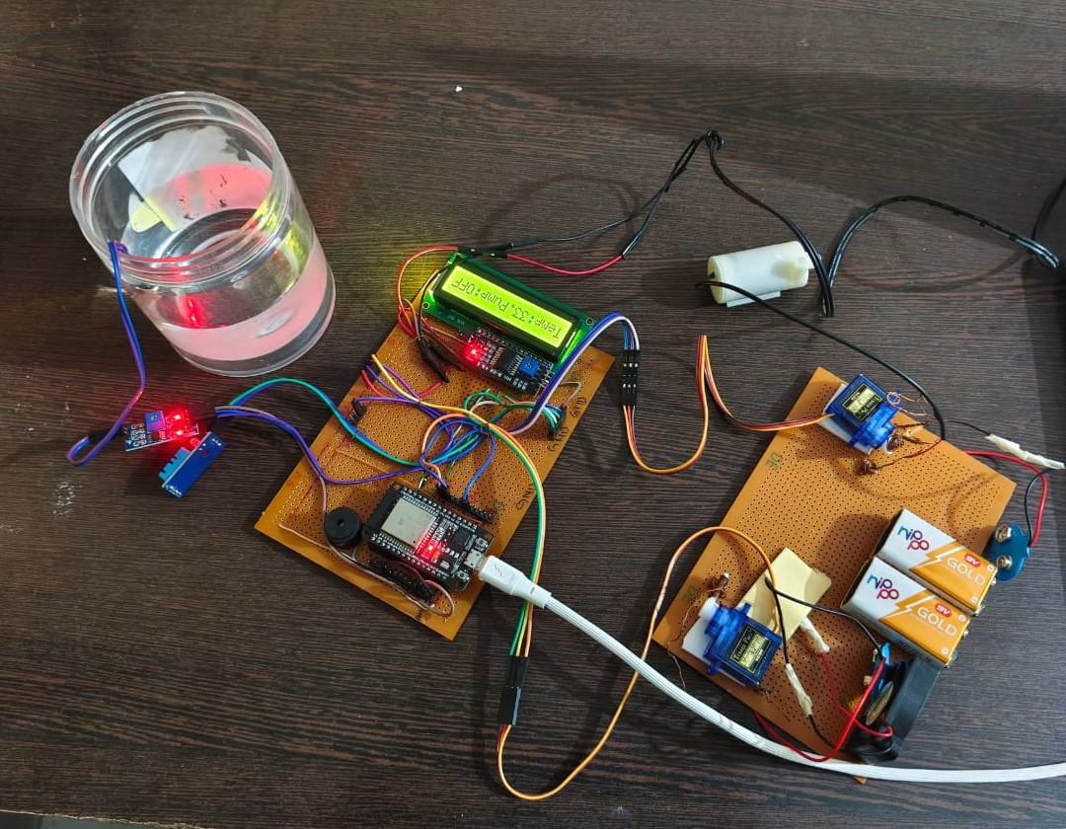
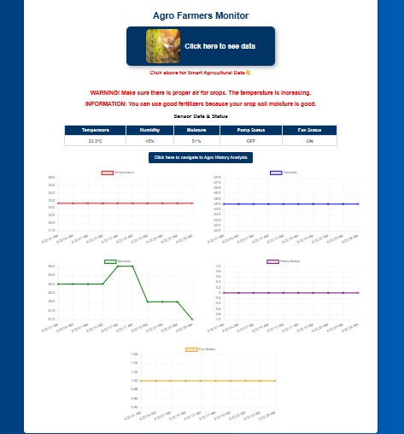
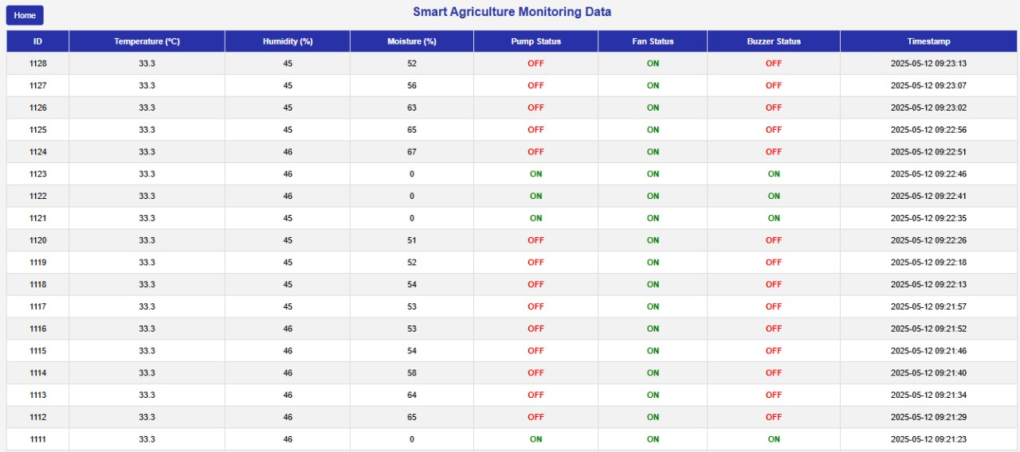
Outcome : Outcome 1

Slide 4
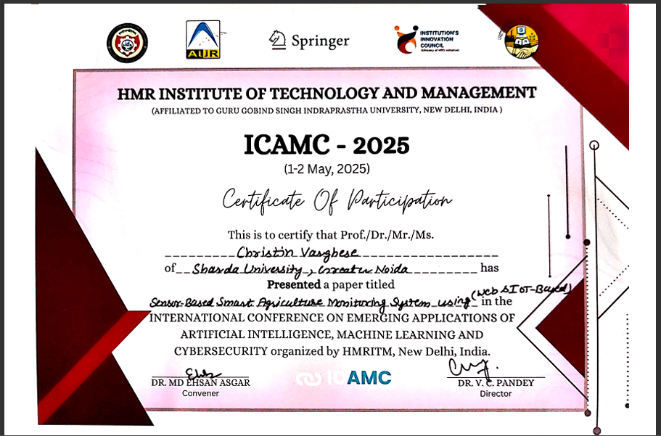
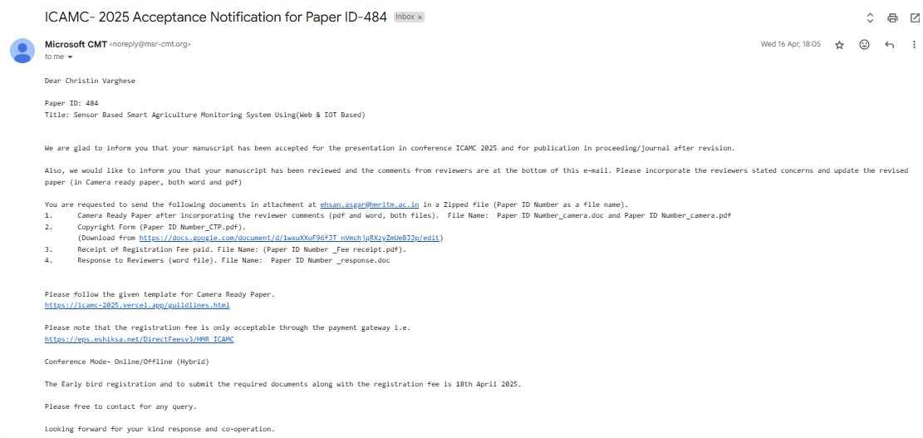
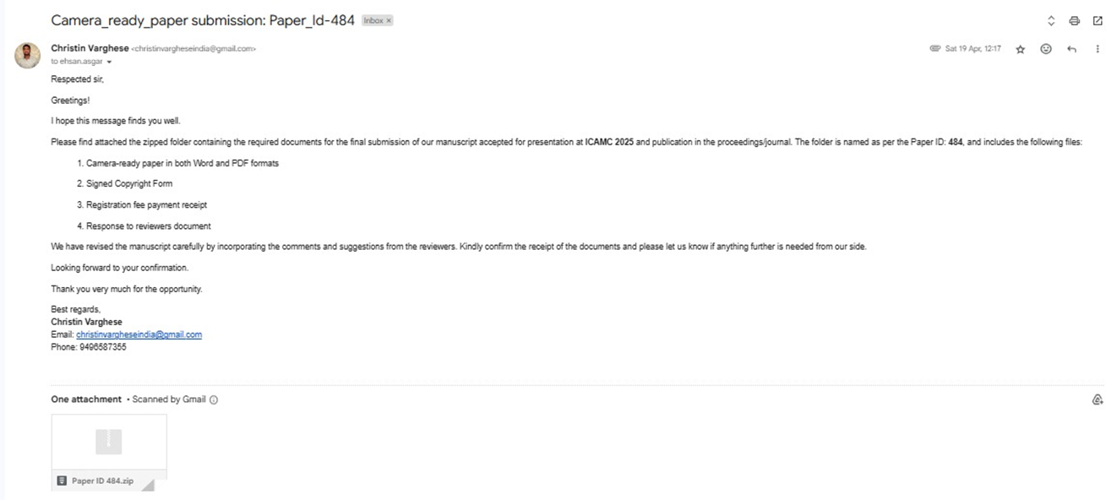
Outcome 2

Slide 5
Workload distribution
Name : Christin Varghese
Role/Responsibilities : Prototype Development ,Web development, Requirement gathering , Implementation , Conference communication & presentation.
Name : Shyam Sunder Kumar
Role/Responsibilities : Research Paper , Literature Review , Report & Docs development, Result & Analysis , Prototype Integration .

Slide 6
Introduction
Sensor Based Smart Agriculture Monitoring System Using Web & IOT Based
The "Sensor-Based Smart Agriculture Monitoring System using (Web & IoT-Based)" is an innovative project designed to monitor and manage environmental conditions in agricultural fields. This system aims to ensure optimal conditions for crop growth by detecting abnormal temperature and soil moisture fluctuations and alerting the farmer in real-time.
IoT-Based Automation: It leverages IoT technology to automate temperature and soil moisture monitoring, reducing manual effort and enhancing efficiency.
Soil Moisture Analysis: Incorporates a moisture analyzer to measure soil moisture levels, ensuring proper irrigation and preventing overwatering or drought stress.
Sustainable Farming Practices: By preventing temperature- and moisture-related crop damage, this system supports sustainable farming practices and increases agricultural productivity.

Slide 7
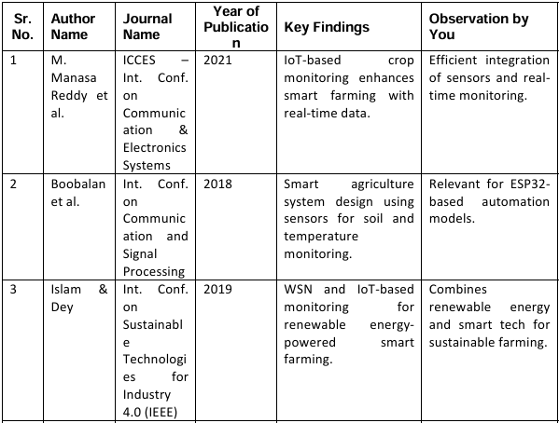

Literature Review:

Slide 8
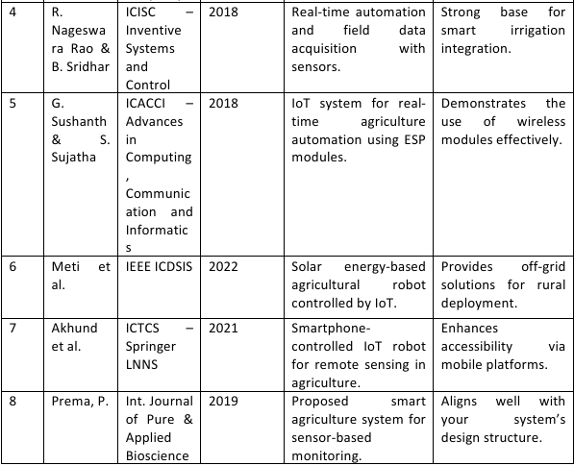

Slide 9
Problem Statement
Agriculture plays a vital role in sustaining the global population, yet farmers face numerous challenges in ensuring optimal crop production. One of the major issues is the unpredictability of environmental factors such as soil moisture, temperature, and humidity, which directly affect plant health and crop yield.
Increasing temperatures and humidity levels due to climate change often lead to plant stress, pest infestations, fungal infections, and reduced productivity.
Water scarcity and inefficient irrigation practices result in overwatering or underwatering, leading to wastage of resources and poor plant growth.
Lack of real-time monitoring and manual observation methods make it difficult for farmers to respond promptly to environmental changes.
Limited access to data-driven insights hampers effective decision-making for irrigation scheduling, fertilization, pest control, and crop management.
A Sensor-Based Smart Agriculture Monitoring System using Web and IoT technologies can provide a real-time solution by integrating sensors and actuators to monitor environmental factors such as soil moisture, temperature, humidity. This system will help farmers optimize their resources, monitor plant health, and automate irrigation and other processes based on data-driven insights. The goal is to create a user-friendly platform accessible through a web interface, where farmers can monitor and automatically control agricultural parameters and efficiently, ultimately improving crop production and sustainability while minimizing costs and environmental impact. This system can also provide predictive analytics to help in making informed decisions for irrigation, fertilization, pest control, and crop management based on historical data and weather conditions

Slide 10
Objectives
To design a Sensor-Based Smart Agriculture Monitoring System using sensors & actuators to alert users when critical thresholds are reached in agricultural fields for monitoring purposes..
To create and manage historical data tables for analyzing trends in temperature and soil moisture levels over time.
To develop a web-based interface for real-time temperature and moisture monitoring with clear alert visualization.
To implement a web-based analysis tool that provides actionable insights into temperature and moisture variations, aiding farmers in informed decision-making.
To ensure the system is scalable, user-friendly, and cost-effective, suitable for practical implementation in agriculture to enhance productivity and sustainability.

Slide 11
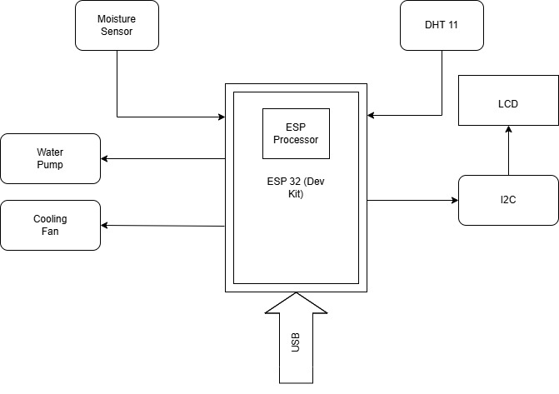
Proposed Methodology
Design of the prototype system
Proposed block diagram

Slide 12
Main Components & Functions:
ESP32 Development Kit: Central controller; processes sensor data & manages devices.
Soil Moisture Sensor: Measures soil moisture; triggers water pump for irrigation.
DHT11 Sensor: Monitors temperature & humidity; provides data for analysis.
Water Pump: Automated on/off based on soil moisture level.
Cooling Fan: Activates when temperature exceeds threshold to protect crops.
LCD Display (I2C Module): Shows real-time data (temp, humidity, moisture).
USB Connection: Used for ESP32 programming & power supply.
Power Adaptor 5V:Used to give external power support to system
Working Principle:
Sensors monitor environmental conditions continuously.
ESP32 processes data, displays it on LCD, and sends live data to the server.
Water pump & cooling fan operate automatically based on threshold values.
Enhances farming efficiency through real-time monitoring & automation.

Slide 13
Implementation
Step 1: Hardware Installation & Integration
Select and connect Soil Moisture Sensor (for soil water content).Connect DHT11 Sensor (for temperature & humidity).Use ESP32 Microcontroller for data collection. Connect Servo Module for controlling water pump & cooling fan.
Step 2: ESP32 Data Transmission & IoT Communication
Configure Wi-Fi settings on ESP32.Send sensor data to Web Application via HTTP. Store data in MySQL Database using PHP script on XAMPP Server.
Step 3: Web Dashboard Development
Develop a PHP-based Web Panel for real-time monitoring. Display sensor data visualization (charts, indicators). Implement automatic control logic based on soil moisture & temperature thresholds.
Step 4: Automation & Notifications
Auto-switch pump ON/OFF based on soil moisture levels. Auto-activate cooling fan if temperature exceeds limit. Provide real-time alerts & notifications for critical conditions.
Step 5: Testing & Validation
Unit Testing of ESP32, sensors, and actuators. Integration Testing of data flow from ESP32 to Web Server. Field Testing in real farm conditions for performance verification.

Slide 14
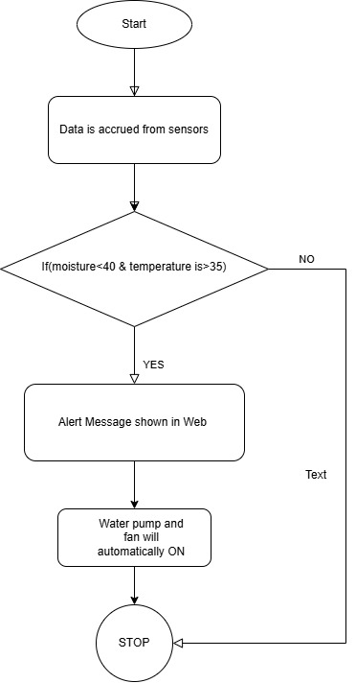
Flow Chart

Slide 15
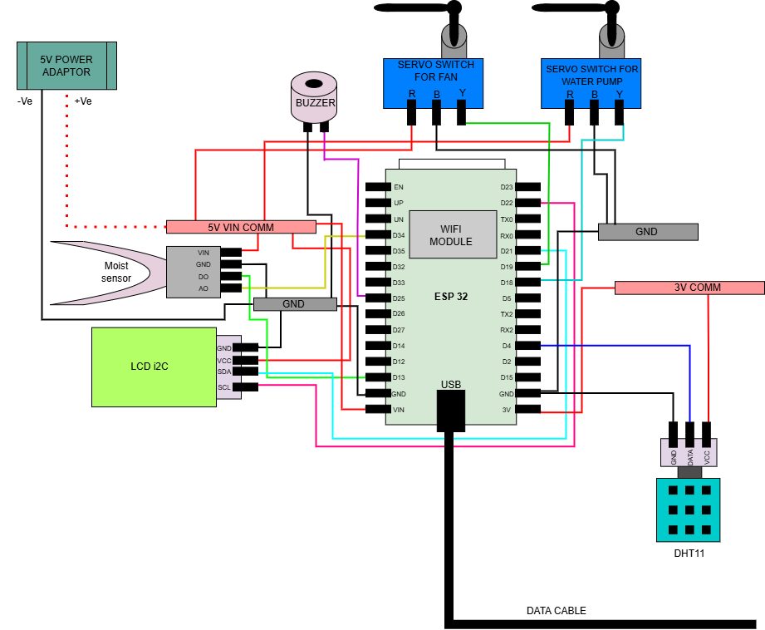
Connection Diagram

Slide 16
Result & Discussion
Real-time Monitoring of environmental parameters (soil moisture, temperature, humidity, light).
Automatic Water Pump Control based on soil moisture detection.
Cooling Fan Activation when temperature exceeds 30°C (DHT11 sensor data).
Automation Power Control ensures efficient irrigation and climate control.
Alerts & Notifications for extreme conditions (drought, high temperature).
Successful Data Transmission to PHP-MySQL server for storage & analysis.
Graphical Data Visualization with real-time charts for easy analysis of agricultural conditions.

Slide 17
Graphical Representation

Slide 18
Discussion
The IoT-based monitoring efficiency system provided real-time information on humidity and temperature so that farmers could determine their data. Automating irrigation and ventilation has significantly reduced water and electricity consumption. The accuracy and response time of the system depend on the performance of the ESP32 microcontroller
Parameter | Traditional Farming | IoT-Based Smart Farming
Water Usage | High (Manual Irrigation) | Optimized (Automated Control)
Labor Requirement | High (Manual Monitoring) | Reduced (Remote Access)
Data Monitoring | No Real-Time Data | Continuous Sensor Data
System Efficiency | Low | High (Data-Driven)
Response Time | Delayed Actions | Instant Alerts & Control

Slide 19
Future Directions of Smart Agriculture Monitoring System (Web & IoT)
AI & Machine Learning(Predictive models for yield, irrigation & disease detection. Automated pest & disease recognition via image processing).
Enhanced Communication(5G & Lora WAN for remote connectivity. Edge computing for faster data processing).
Advanced Sensors(Multi-parameter sensors (pH, nutrients, weather).Drone-based large-scale field monitoring).
Energy Optimization(Solar-powered IoT devices. Energy-efficient protocols for longer battery life).
Blockchain Security(Secure, tamper-proof data storage. Smart contracts for agriculture).
Scalable Architecture(Modular & cloud-based microservices. Easily expandable for large farms).
Automated Decision-Making(Smart control of irrigation, fertilization, pest control. Voice assistant integration).
User-Friendly Apps(Simple UI for farmers. Mobile apps with multi-language support).
Multi-Platform Compatibility(Works on web, Android, iOS. Integrates with existing smart farming systems).
Environmental Sustainability(Precision agriculture to reduce water & chemical use.IoT-based waste management solutions).

Slide 20
Conclusion
This project presented a sensor-based smart agricultural monitoring system using Web and IoT, aiming to optimize agricultural practices through automation, remote monitoring, and data-driven decision-making. The system utilized an ESP32 microcontroller integrated with various sensors, including soil moisture, temperature, and humidity sensors. Real-time data from these sensors were transmitted to a web-based dashboard, allowing farmers to monitor and control environmental conditions remotely. Key features included automated irrigation, real-time alerts, and data visualization. The system successfully reduced water usage, minimized manual labor, and improved resource management, contributing to more sustainable and efficient agricultural practices.

Slide 21
References
[1] M. M. Reddy, K. R. V. Krishna, A. K. Rao, and M. Gopi, "IoT-Based Crop Monitoring System for Smart Farming," in Proc6th Int. Conf. Commun. Electron. Syst. (ICCES), India, 2021, pp. 562–568.
[2] J. Boobalan, V. Jacintha, J. Nagarajan, K. Thangayogesh, and S. Tamilarasu, "An IoT-Based Agriculture Monitoring System," in Proc. Int. Conf. Commun. Signal Process., India, 2018, pp. 1–5.
[3] M. S. Islam and G. K. Dey, "Precision Agriculture: Renewable Energy Based Smart Crop Field Monitoring and Management System Using WSN via IoT," in Proc. Int. Conf. Sustain. Technol. Ind. 4.0 (STI), Dhaka, 2019, pp. 1–6.
[4] R. N. Rao and B. Sridhar, "IoT Based Smart Crop-Field Monitoring and Automation Irrigation System," in Proc. 2nd Int. Conf. Inventive Syst. Control (ICISC), India, 2018, pp. 1–6.
[5] G. Sushanth and S. Sujatha, "IoT Based Smart Agriculture System," in Proc. Int. Conf. Adv. Comput. Commun. Inform. (ICACCI), Bangalore, 2018, pp. 1014–1019.
[6] A. G. Meti, P. N. Rayangoudra, K. S. Biradar, V. Kumar, G. H. Manoj, and B. T. V. Murthy, "IoT and Solar Energy Based Multipurpose Agricultural Robot for Smart Farming," in Proc. IEEE Int. Conf. Data Sci. Inf. Syst. (ICDSIS), India, 2022, pp. 1–6.
[7] T. M. N. U. Akhund, M. R. Hossain, N. T. Newaz, and M. S. Kaiser, "Low-Cost Smartphone-Controlled Remote Sensing IoT Robot," in M. S. Kaiser et al. (eds.), ICTCS 2020, Lecture Notes in Networks and Systems, vol. 190, Singapore: Springer, 2021, pp. 1–10.
[8] P. Prema, "Smart Agriculture Monitoring System Using IoT," Int. J. Pure Appl. Biosci., vol. 7, no. 1, pp. 1–5, 2019.
[9] A. Sharma, R. Patel, and S. Verma, "IoT-Based Smart Irrigation System Using ESP32," Int. J. Smart Agric., vol. 8, no. 2, pp. 45–58, 2021.
[10] N. Gondchawar and R. S. Kawitkar, "IoT-Based Smart Agriculture," Int. J. Adv. Res. Comput. Eng. Technol. (IJARCET), vol. 5, no. 6, pp. 838–842, 2016.

Slide 22
[11] V. Patil and S. Kale, "Smart Greenhouse Monitoring System Using IoT," Int. J. Eng. Res. Technol. (IJERT), vol. 9, no. 4, pp. 98–103, 2020.
[12] K. Gupta, P. Sharma, and A. Singh, "Web-Based Remote Monitoring of IoT Smart Agriculture System," J. Web Internet Things Res., vol. 11, no. 1, pp. 23–37, 2022.
[13] R. Shinde and M. Kulkarni, "XAMPP-Based IoT Smart Farming System Using ESP32," in Proc. Int. Conf. Emerge. Technol. IoT, vol. 4, no. 3, pp. 12–19, 2021.
[14] T. Raj and V. Nair, "Cloud-Based IoT Solutions for Smart Agriculture: A Thing Speak & Firebase Approach," in IEEE IoT Conf. Proc., vol. 7, no. 1, pp. 112–120, 2020.
[15] M. Kumar, A. Rao, and P. Mehta, "Machine Learning Integration in IoT Agriculture for Predictive Analytics," J. AI Smart Farming, vol. 6, no. 2, pp. 45–63, 2023.
[16] S. Das and P. Kumar, "AI-Based Disease Detection in Smart Farming Using IoT Sensors," Int. J. Agric. AI Syst., vol. 5, no. 1, pp. 33–50, 2022.
[17] B. Chakraborty and N. Iyer, "AWS IoT for Automated Smart Farming Solutions," J. Cloud Comput. IoT Res., vol. 4, no. 4, pp. 20–35, 2021.
[18] P. Mishra and K. Verma, "Relay Module-Based Water Pump Control in IoT Smart Irrigation," IEEE Trans. Smart Agric., vol. 9, no. 3, pp. 54–72, 2020.
[19] Z. Ahmed and A. Rehman, "LoRa-Based IoT Agriculture Monitoring System for Remote Farms," IoT J. Wireless Sensor Network., vol. 3, no. 2, pp. 28–42, 2019.
[20] S. Banerjee and R. Gupta, "Solar-Powered IoT Devices for Smart Agriculture: A Sustainable Approach," Renew. Energy IoT J., vol. 8, no. 1, pp. 15–30, 2022.

Slide 23
Annexure
Annexure A: System Components Hardware: Sensors (Temperature, Humidity, Soil Moisture), Microcontroller (ESP32), Connectivity (Wi-Fi), Actuators (Pumps and Fan).
Software: Arduino IDE, VS Code , XAMP Server .
Annexure B: Circuit Diagram and Architecture Circuit Diagram of the IoT Setup.
System Architecture (Sensors → Microcontroller → Server → User Interface).
Annexure C: Source Code, Microcontroller Code (ESP32).
Web Application Code (PHP, HTML, CSS, JS).
Annexure D: Sensor Calibration (Calibration methods for Temperature, Humidity, and Soil Moisture sensors). Threshold Values for Actuators.
Annexure E: Test Results Test Data for Sensor Accuracy. Error Margins and Observations.
Annexure F: References Research Papers. Technical Manuals for Components

Slide 24
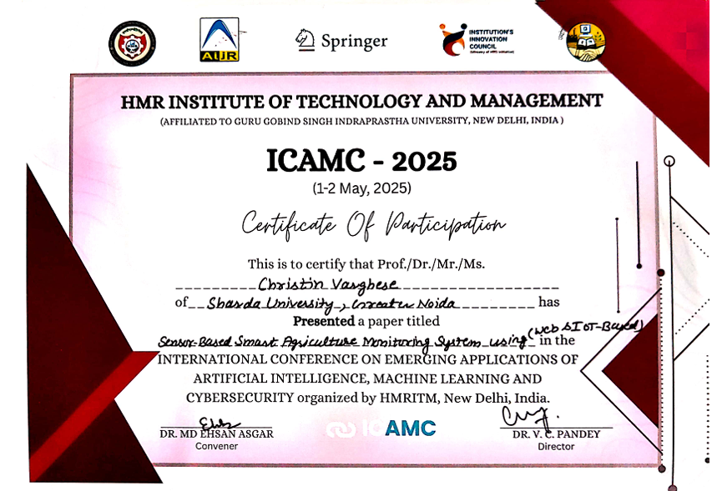
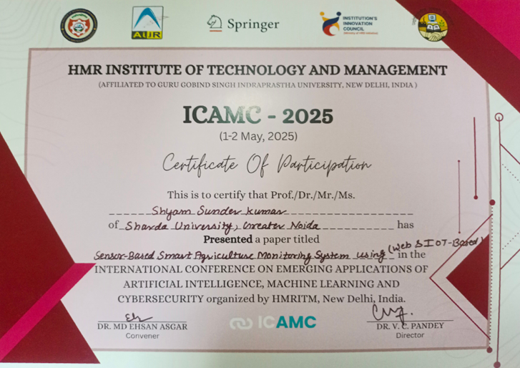
Major Outcome Achieved
1.Developed full working prototype
2.Presented in ICAMC conference and put forward for publish

Slide 25
Thank You

